Slide 1


Sleep Analysis for Migraines
By Jessica Baxter

Slide 2
Ask:
Lack of sleep is one of my major triggers for migraines. I want to figure out if there is a particular day of the week I tend to get less sleep, in order to either change the habit or be able to better predict a migraine.

Slide 3
Prepare & Process:
Date | Day of the Week | Total Sleep Time (in hours) | Light Sleep (in hours) | Deep Sleep (in hours) | REM Sleep (in hours) | Awake (in minutes | Avg SpO2 | Avg Respiration | Resting Heart Rate (bpm)
1/30/2024 | Tuesday | 8.56 | 7.27 | 0.48 | 0.41 | 11 | 92% | 13 brpm | 72
1/29/2024 | Wednesday | 6.41 | 4.51 | 1 | 0.5 | 16 | 87% | 12 brpm | 70
1/28/2024 | Thursday | 9.45 | 7.1 | 1.9 | 1.35 | 9 | 90% | 13 brpm | 71
1/27/2024 | Friday | 9.3 | 5.42 | 1.23 | 1.58 | 1 | 90% | 12 brpm | 68
1/26/2024 | Saturday | 9.56 | 7.48 | 1.4 | 1.4 | 33 | 93% | 12 brpm | 67
1/25/2024 | Sunday | 10.12 | 7.26 | 1.21 | 1.25 | 11 | 87% | 12 brpm | 67
1/24/2024 | Monday | 9.4 | 7.26 | 0.55 | 0.43 | 11 | 88% | 12 brpm | 66
1/23/2024 | Tuesday | 9.6 | 6.38 | 1.39 | 0.49 | 14 | 87% | 12 brpm | 67
1/22/2024 | Wednesday | 8.5 | 6.4 | 1.24 | 0.46 | 6 | 93% | 13 brpm | 68
1/21/2024 | Thursday | 10.1 | 7.28 | 0.49 | 1.44 | 6 | 92% | 12 brpm | 68
1/20/2024 | Friday | 8.47 | 5.18 | 1.55 | 1.34 | 1 | 90% | 12 brpm | 68
1/19/2024 | Saturday | 11.8 | 8.31 | 0.59 | 1.38 | 7 | 91% | 12 brpm | 64
1/18/2024 | Sunday | 6.5 | 4.22 | 1.5 | 0.38 | 10 | 91% | 13 brpm | 73
1/17/2024 | Monday | 8.52 | 6.14 | 1.17 | 1.21 | 7 | 91% | 12 brpm | 67

Slide 4
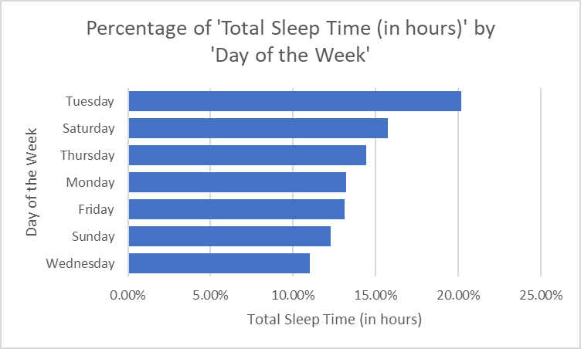
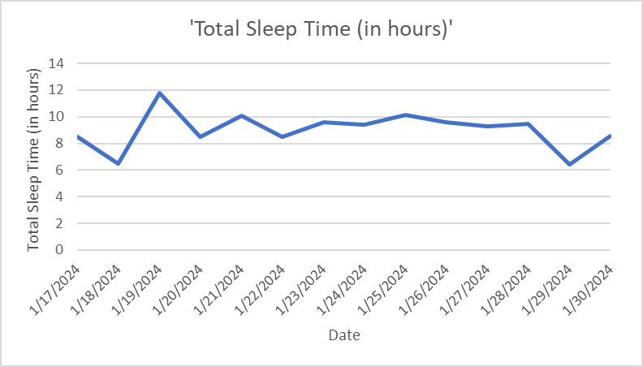
Analyze:
 | Total Sleep Time (in hours) | Light Sleep (in hours) | Deep Sleep (in hours) | REM Sleep (in hours) | Awake (in minutes | Avg SpO2 |  | Resting Heart Rate (bpm)
Averages: | 9.0207143 | 6.4435714 | 1.121429 | 0.972857 | 10.21429 | 90% |  | 68.28571429
On average, over the past 2 weeks I have an average of 9 hours of total sleep time, an average of 6.5 hours of light sleep, 1 hour of deep sleep, and almost 1 hour of REM sleep with only about an average of 10 waking minutes during sleep. Over the past 2 week I slept more on Tuesdays and less on Wednesdays. When charting out the 2 weeks over time you can see that the dates around weekends tends to be very sporadic.

Slide 5
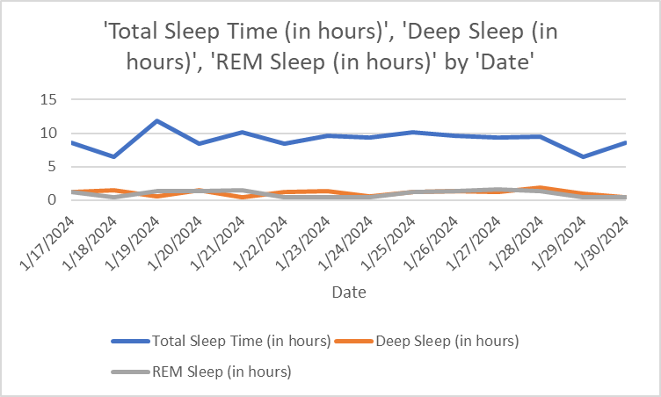
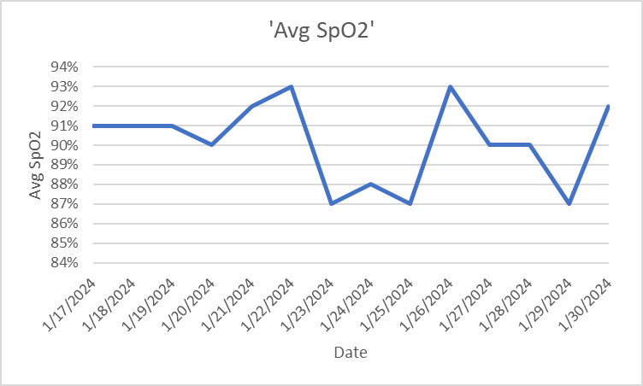
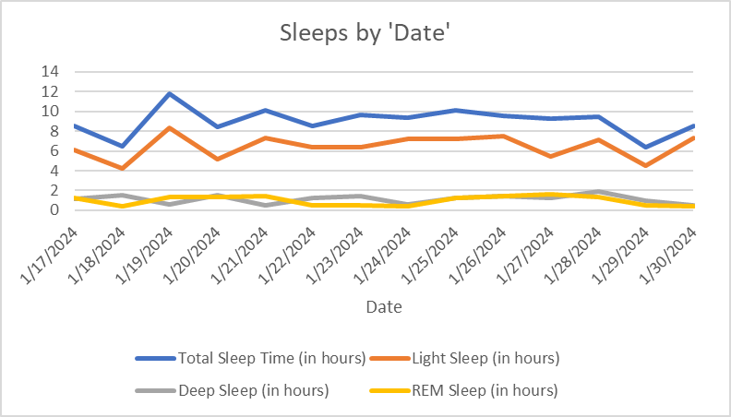
Analyze:
An interesting observation is that my average SpO2 dipped 1/23/2024-1/25/2024 a Tuesday-Thursday
My total sleep and light sleep seem to be correlated while my deep sleep and REM sleep seem to be partially inversely correlated.

Slide 6
Act:
It was interesting to me that over the past 2 weeks I tend to sleep more on Tuesdays and least on Wednesdays. This will give me a good starting point to pay attention to since most of my migraines do tend to develop later in the week.
For my own purposes I would like to expand on these findings and possibly gather data over a longer period of time to see if other patterns reveal themselves.
I would also like to see if other variables are at play here, I have been sick over the past couple of days which could skew the data as I was sleeping more than usual. I would also be interested in confounding factors playing a role in my sleep patterns, for instance, my partner works late on Tuesdays which might be the reason I might go to bed earlier than I might during the rest of the week.

